Slide 1

The scale and pace of crises pose enormous challenges for the Crisis Management (CM) sector, with new threats emerging all the time.

Slide 2
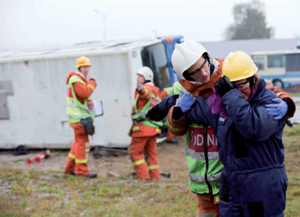
An already complex field must also strive to integrate new technologies and methods, cope with a rapidly changing infrastructure, understand evolving risks, be effective across cultural, administrative and national boundaries and engage with populations to enhance their resilience.

Slide 3
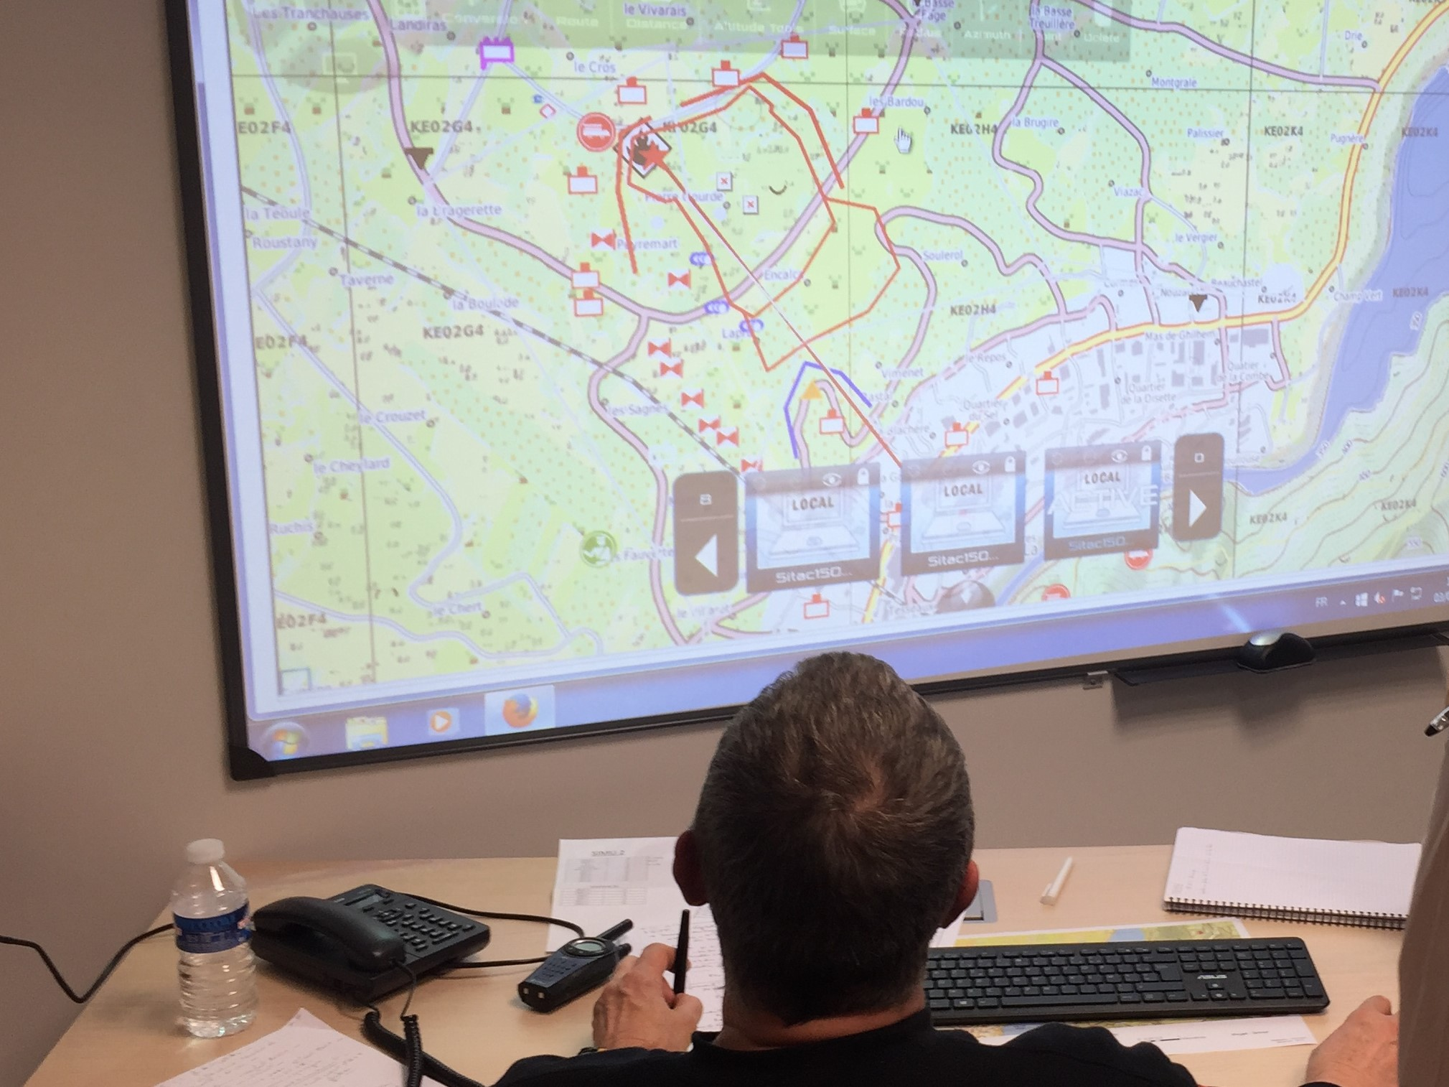
Innovation is therefore critical, but will only be successful if it is relevant and accessible to practitioners and operators. CM innovation must therefore be capable of meeting these multifaceted challenges and delivering solutions that are modular, flexible and adaptable.

Slide 4
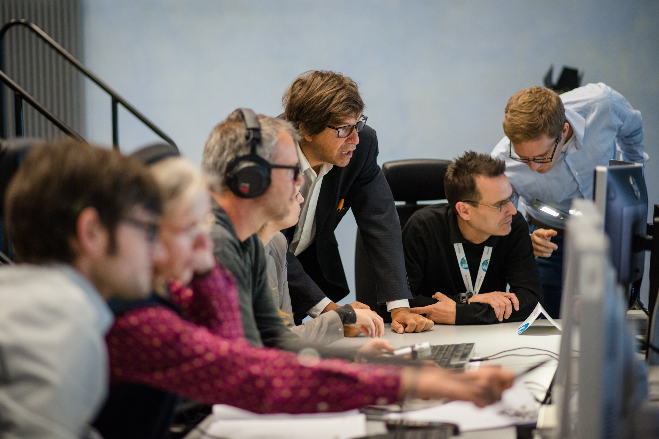
These solutions must be tested and validated in realistic environments; they must be evaluated to assess their true benefits and for their overall suitability, before being adopted by end-users.

Slide 5





In May 2014, dedicated practitioners’ organisations, research institutes, industries and SMEs teamed up to support the European Union to tackle this issue.

Slide 6
































Slide 7

Until April 2020 the broad aim of the DRIVER+ project, funded under the European Union’s 7th Framework Programme,

Slide 8


will be to improve the way capability development and innovation management are addressed, by assessing and delivering solutions that can be used, and combined, to address different types of large-scale crises.

Slide 9

But, in order to provide a European answer to the challenges Crisis Management is facing today and tomorrow, the involvement of as many concerned stakeholders as possible is essential. For this reason, the selection of solutions to be tested within DRIVER+, should be provided by current partners and external organisations to extend the knowledge base.

Slide 10
DRIVER+ is following a practitioner-driven approach.
Therefore, both the selection of solutions and the review process should not only be neutral and transparent, but also driven by the end-users.

Slide 11
The objectives of DRIVER+ are:

Slide 12
To develop a pan-European Test-bed for Crisis Management capability development

Slide 13
To develop a comprehensive Portfolio of Crisis Management Solutions

Slide 14
To facilitate a shared understanding in Crisis Management across Europe

Slide 15
The DRIVER+ Test-bed is a pan-European arena of virtually connected facilities and crisis labs

Slide 16
developed to create space for trialling solutions.

Slide 17
The Test-bed aims at
Providing a pragmatic step-by-step guidance to conduct trials
Providing general guidance and the technical infrastructure of the Test-bed to support the trials
4.
1.
Providing a reference implementation for all DRIVER+ trials
3.
2.
Creating a demonstration infrastructure where stakeholders can collaborate in trialling and evaluating new tools, processes or organisational solutions

Slide 18
The Test-bed aims at
Providing a pragmatic step-by-step guidance to conduct trials
Providing general guidance and the technical infrastructure of the Test-bed to support the trials
4.
1.
Providing a reference implementation for all DRIVER+ trials
3.
2.
Creating a demonstration infrastructure where stakeholders can collaborate in trialling and evaluating new tools, processes or organisational solutions

Slide 19
The Test-bed aims at
Providing a pragmatic step-by-step guidance to conduct trials
Providing general guidance and the technical infrastructure of the Test-bed to support the trials
4.
1.
Providing a reference implementation for all DRIVER+ trials
3.
2.
Creating a demonstration infrastructure where stakeholders can collaborate in trialling and evaluating new tools, processes or organisational solutions

Slide 20
The Test-bed aims at
Providing a pragmatic step-by-step guidance to conduct trials
Providing general guidance and the technical infrastructure of the Test-bed to support the trials
4.
1.
Providing a reference implementation for all DRIVER+ trials
3.
2.
Creating a demonstration infrastructure where stakeholders can collaborate in trialling and evaluating new tools, processes or organisational solutions

Slide 21
The DRIVER+ Portfolio of Solutions is a database-driven online catalogue

Slide 22
The Portfolio of Solutions aims at
Documenting and presenting details on solutions tested and evaluated during the DRIVER+ Trials
2.
3.
1.
Allowing for the introduction of third party solutions already used by practitioners or relevant to Crisis Management
Supporting the sharing of user experiences, and thereby, easing the successful implementation and usage of solutions for other practitioners

Slide 23
The Portfolio of Solutions aims at
Documenting and presenting details on solutions tested and evaluated during the DRIVER+ Trials
2.
3.
1.
Allowing for the introduction of third party solutions already used by practitioners or relevant to Crisis Management
Supporting the sharing of user experiences, and thereby, easing the successful implementation and usage of solutions for other practitioners

Slide 24
The Portfolio of Solutions aims at
Documenting and presenting details on solutions tested and evaluated during the DRIVER+ Trials
2.
3.
1.
Allowing for the introduction of third party solutions already used by practitioners or relevant to Crisis Management
Supporting the sharing of user experiences, and thereby, easing the successful implementation and usage of solutions for other practitioners

Slide 25
Finally, DRIVER+ aims at enhancing the cooperation framework
and facilitating a shared understanding in Crisis Management.

Slide 26
How?

Slide 27
Enhancing the shared understanding by:
Cooperating with CM experts, practitioners and solution providers external to DRIVER+
Organising I4CM events (Innovation for Crisis Management) that bring together solution providers practitioners at local/regional level and relay the Community of Users on European level
4.
5.
1.
3.
Building and structuring a dedicated Community of Practice in Crisis Management to facilitate identification of best practises and sharing of lessons learnt
2.
Developing new standards and/or contributing to ongoing and future standard development
Organising 3 Policy-Research Roundtables to exchange with policy-makers on project results and potential EU policy implications

Slide 28
Enhancing the shared understanding by:
Cooperating with CM experts, practitioners and solution providers external to DRIVER+
Organising I4CM events (Innovation for Crisis Management) that bring together solution providers practitioners at local/regional level and relay the Community of Users on European level
4.
5.
1.
3.
Building and structuring a dedicated Community of Practice in Crisis Management to facilitate identification of best practises and sharing of lessons learnt
2.
Developing new standards and/or contributing to ongoing and future standard development
Organising 3 Policy-Research Roundtables to exchange with policy-makers on project results and potential EU policy implications

Slide 29
Enhancing the shared understanding by:
Cooperating with CM experts, practitioners and solution providers external to DRIVER+
Organising I4CM events (Innovation for Crisis Management) that bring together solution providers practitioners at local/regional level and relay the Community of Users on European level
4.
5.
1.
3.
Building and structuring a dedicated Community of Practice in Crisis Management to facilitate identification of best practises and sharing of lessons learnt
2.
Developing new standards and/or contributing to ongoing and future standard development
Organising 3 Policy-Research Roundtables to exchange with policy-makers on project results and potential EU policy implications

Slide 30
Enhancing the shared understanding by:
Cooperating with CM experts, practitioners and solution providers external to DRIVER+
Organising I4CM events (Innovation for Crisis Management) that bring together solution providers practitioners at local/regional level and relay the Community of Users on European level
4.
5.
1.
3.
Building and structuring a dedicated Community of Practice in Crisis Management to facilitate identification of best practises and sharing of lessons learnt
2.
Developing new standards and/or contributing to ongoing and future standard development
Organising 3 Policy-Research Roundtables to exchange with policy-makers on project results and potential EU policy implications

Slide 31
Enhancing the shared understanding by:
Cooperating with CM experts, practitioners and solution providers external to DRIVER+
Organising I4CM events (Innovation for Crisis Management) that bring together solution providers practitioners at local/regional level and relay the Community of Users on European level
4.
5.
1.
3.
Building and structuring a dedicated Community of Practice in Crisis Management to facilitate identification of best practises and sharing of lessons learnt
2.
Developing new standards and/or contributing to ongoing and future standard development
Organising 3 Policy-Research Roundtables to exchange with policy-makers on project results and potential EU policy implications

Slide 32
But…
How will we reach these 3 objectives?
To develop a pan-European Test-bed for Crisis Management
capability development
To facilitate a shared understanding in Crisis Management across Europe
To develop a comprehensive Portfolio of Crisis Management Solutions

Slide 33
TRIALS Poland, France, Austria, The Netherlands
FINAL DEMO Poland/Italy
To develop a pan-European Test-bed for Crisis Management
capability development
To facilitate a shared understanding in Crisis Management across Europe
To develop a comprehensive Portfolio of Crisis Management Solutions

Slide 34
Trials
4 EVENTS TO OPERATIONALISE AND TEST
both THE SOLUTIONS and the test-bed components
Poland, France, Austria, The Netherlands

Slide 35
Trials
4 EVENTS TO OPERATIONALISE AND TEST
both THE SOLUTIONS and the test-bed components
Poland, France, Austria, The Netherlands
Based on updated Crisis Management gaps and practitioner needs

Slide 36
Trials
4 EVENTS TO OPERATIONALISE AND TEST
both THE SOLUTIONS and the test-bed components
Poland, France, Austria, The Netherlands
Based on updated Crisis Management gaps and practitioner needs
Benefiting from the DRIVER+ Test-bed components

Slide 37
Trials
4 EVENTS TO OPERATIONALISE AND TEST
both THE SOLUTIONS and the test-bed components
Poland, France, Austria, The Netherlands
Based on updated Crisis Management gaps and practitioner needs
Benefiting from the DRIVER+ Test-bed components
All results to be made available in the Portfolio of Solutions

Slide 38
Final demonstration
1 EVENT TO Showcase THE SOLUTIONS, THEIR EFFICIENCY AND EU ADDED-VALUE
Italy and Poland

Slide 39
Final demonstration
1 EVENT TO Showcase THE SOLUTIONS, THEIR EFFICIENCY AND EU ADDED-VALUE
Italy and Poland
Building upon the results
of the trials and the lessons learnt from reference implementations and design validation of the Test-bed

Slide 40
Final demonstration
1 EVENT TO Showcase THE SOLUTIONS, THEIR EFFICIENCY AND EU ADDED-VALUE
Italy and Poland
Building upon the results
of the trials and the lessons learnt from reference implementations and design validation of the Test-bed
Showcasing the benefits that DRIVER+ Solutions may represent for the Emergency Response Coordination Centre (ERCC) activities.

Slide 41

Final demonstration
1 EVENT TO Showcase THE SOLUTIONS, THEIR EFFICIENCY AND EU ADDED-VALUE
Italy and Poland
Building upon the results
of the trials and the lessons learnt from reference implementations and design validation of the Test-bed
Showcasing the benefits that DRIVER+ Solutions may represent for the Emergency Response Coordination Centre (ERCC) activities.
Presenting the potential of a more integrated high-level CM system in Europe

Slide 42
TRIALS Poland, France, Austria, The Netherlands
FINAL DEMO Poland/Italy
Portfolio of Solutions
Test-bed
Shared understanding
EXTERNAL COOPERATION An inclusive approach
I4CMs Poland, Denmark
POLICY-DIALOGUE
ROUNDTABLES Poland, Denmark, Belgium
How will we increase the impact?

Slide 43
Innovation for crisis management (I4CM) events
UNIQUE LOCAL EXCHANGE FORUMS ON PRACTITIONERS’ NEEDS AND SOLUTIONS
Poland and Denmark

Slide 44

Innovation for crisis management (I4CM) events
UNIQUE LOCAL EXCHANGE FORUMS ON PRACTITIONERS’ NEEDS AND SOLUTIONS
Poland and Denmark
To address pressing regional issues to be solved, identify best practices, foster synergies, and address issues of common interest

Slide 45

Innovation for crisis management (I4CM) events
UNIQUE LOCAL EXCHANGE FORUMS ON PRACTITIONERS’ NEEDS AND SOLUTIONS
Poland and Denmark
To address pressing regional issues to be solved, identify best practices, foster synergies, and address issues of common interest
To exchange on (future) needs of practitioners, already available promising solutions to address them and those that are still to be developed

Slide 46

Innovation for crisis management (I4CM) events
UNIQUE LOCAL EXCHANGE FORUMS ON PRACTITIONERS’ NEEDS AND SOLUTIONS
Poland and Denmark
To address pressing regional issues to be solved, identify best practices, foster synergies, and address issues of common interest
To exchange on (future) needs of practitioners, already available promising solutions to address them and those that are still to be developed
To provide a relay towards the European level

Slide 47
Innovation for crisis management (I4CM) events
UNIQUE LOCAL EXCHANGE FORUMS ON PRACTITIONERS’ NEEDS AND SOLUTIONS
Poland and Denmark
To address pressing regional issues to be solved, identify best practices, foster synergies, and address issues of common interest
To exchange on (future) needs of practitioners, already available promising solutions to address them and those that are still to be developed
To provide a relay towards the European level

Slide 48
POLICY-RESEARCH DIALOGUE ROUNDTABLES
Strengthening the Policy-Research Dialogue on research and demonstration activities in Crisis Management
Poland, Denmark and Belgium

Slide 49

POLICY-RESEARCH DIALOGUE ROUNDTABLES
Strengthening the Policy-Research Dialogue on research and demonstration activities in Crisis Management
Poland, Denmark and Belgium
Two before the trials and final demonstration to allow exchanges on the potential EU policies to be addressed and the involvement of DG HOME, DG ECHO /ERCC staff

Slide 50

POLICY-RESEARCH DIALOGUE ROUNDTABLES
Strengthening the Policy-Research Dialogue on research and demonstration activities in Crisis Management
Poland, Denmark and Belgium
Two before the trials and final demonstration to allow exchanges on the potential EU policies to be addressed and the involvement of DG HOME, DG ECHO /ERCC staff
One after the events to allow exchanges on the results and the potential policy implications

Slide 51
External cooperation
A project opening up to the worLD

Slide 52

External cooperation
A project opening up to the worLD
Identify external innovative solution providers and interested practitioners

Slide 53

External cooperation
A project opening up to the worLD
Identify external innovative solution providers and interested practitioners
Enable their participation and direct technical contribution to DRIVER+ trials, to ensure their high quality, relevance and appropriateness

Slide 54
External cooperation
A project opening up to the worLD
Identify external innovative solution providers and interested practitioners
Enable their participation and direct technical contribution to DRIVER+ trials, to ensure their high quality, relevance and appropriateness

Slide 55

Are you an expert or a practitioner?
Are you a solution provider?
Are you involved in a related project or initiative?
Are you a policy-maker impacted by Crisis Management issues?

Slide 56
Register to the Online Community Platform today
at this booth
&
Let us hear your voice!

